Slide 1
Parent Orientation
2023

Slide 2
Table of Contents
Our League
Who We Serve
District 8
Registration
Baseball Divisions
Softball Divisions
League Objectives
Parent Code of Conduct
You’re Role as a Parent
Team Formation
Volunteering
Coaches
Umpires
Field Maintenance
Fundraising / Matching Funds
League Scheduling
All Stars
Contact Information
Closing

Slide 3
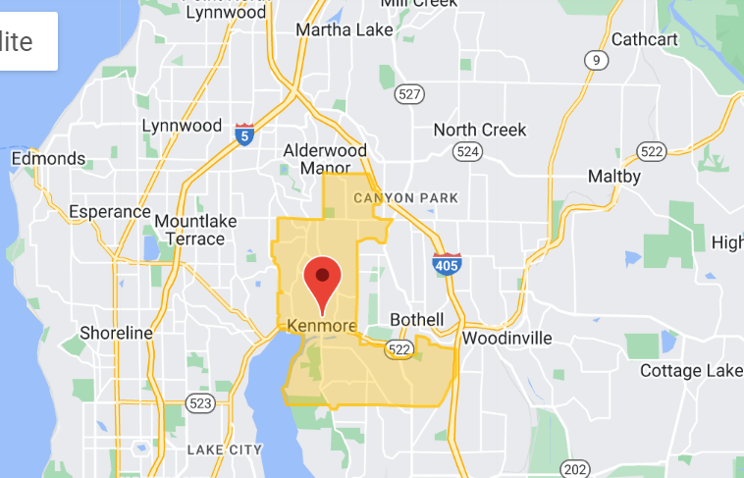
Our league – who we serve
Northlake little league (NLLL) serves Kenmore and areas of Brier, Bothell and unincorporated Snohomish county
Our league is mostly players who attend Sheltonview, frank love, lockwood, Kenmore, arrowhead and moorlands elementary schools
Type your address at this link to find your league: https://www.littleleague.org/play-little-league/league-finder/

Slide 4
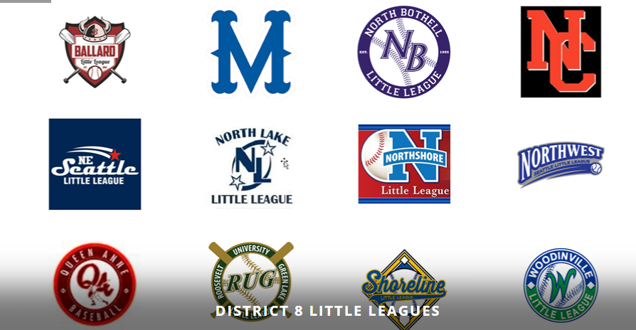
Our league – district 8
NLLL is part of Washington Little league District 8 with 11 other leagues. We play in the “north end” with North Bothell, northshore and Woodinville little leagues
Other teams in D8 are Ballard, magnolia, north central, northeast, northwest, queen Anne, rug and shoreline
https://www.llwadistrict8.org/

Slide 5
Our league – registration
In 2022, we had 642 players registered for our 13 baseball and softball programs
  T-Ball – 99*
  Baseball – 363
  Softball – 148
  Challenger – 25
For more information about available divisions, see next slide
*note: Quickball is replacing t-ball in 2023. For more information on Quickball, visit https://docs.google.com/presentation/d/1hw-WRXWtUCNjF_Xt2Z689bu_Ful-Vpb0UxJH6XYFhrw/edit#slide=id.p

Slide 6
Our league – baseball divisions
BB Level | League Age | Description
Beginners | Ages 4-6 | Children league age 4 to 5 typically play Beginners Quickball. New players of league age 6 may find this to be a good fit as well. Quickball is a faster game appropriate for players of this age group. Young players must be able to follow directions and be willing to participate. This is a training ground for our youngest players. For more info, see this presentation. Coed
Rookie | Ages 6-7 | Six-year-olds may play at the Rookie (coach pitch) level if they are comfortable catching, throwing, and swinging at a pitched ball. Most children league age 7 play at the Rookie level if they have learned to catch balls thrown at face level and above with the glove held vertically rather than horizontally and are comfortable hitting a ball pitched by an adult. In this division, batters will hit off a tee, but transition to soft toss pitching. Coed
Sluggers | Ages 7-8 | Instructional league aiming to bridge the gap between Rookie and AAA. Players at this level are beginning to make plays in the field, and can safely handle a ball thrown at face level (or deflect if not yet catching). The player successfully puts the ball in play in most coach-pitch at bats. Slugger games will be comprised of six 3-out innings, use a soft-core baseball, and feature coach pitching. Emphasis is player safety and development. Girls 7-8 may consider transitioning to our softball program. Coed
AAA BB | Ages 8-10 | Most players at this level have learned to consistently catch balls thrown at face level and above with the glove held vertically rather than horizontally. The player successfully puts the ball in play in most coach-pitch at bats. Players in this division will face a standard "hard" baseball. Games follow standard baseball rules, with kids pitching, but have modifications (coach pitching after 4 balls, limited stealing) to encourage player development. May be subject to player assessment. Coed
Minors BB* | Ages 9-11 | Players participate in player assessments and, depending on their fielding and batting abilities, are drafted to play in the Minors or Majors division. Based on ability, players 10 and under may be placed at the AAA level for further player development and playing time. Most 11 year olds will play in this division. Player assessments are only used to equalize the formation of teams and not to determine whether a player plays in the league or not.
Majors BB* | Ages 11-12 | Players participate in player assessments and, depending on their fielding and batting abilities, are drafted to play in the Minors or Majors divisions. A player league age 11 is not automatically rostered in the Majors division. Player assessments are only used to equalize the formation of teams and not to determine whether a player plays in the league or not.
Intermediates / Juniors BB | Ages 13-14 | Intermediate / Juniors provide an alternate playing experience versus more expensive select ball options. Play is more relaxed than select ball, but teams still play for league championships and field all-star teams. Intermediates take place on fields with 70' base paths, Juniors play 90'.
Seniors BB | Ages 15-16 | Depending on interest a Seniors division will be implemented.
Challenger (District 8 program) | All Ages | This division offers those physically or mentally challenged the opportunity to play baseball on a team. Rosters may be combined with other District 8 leagues. Coed

Slide 7
Our league – Softball divisions
SB Level | League Age | Description
Beginners | Ages 4-6 | Children league age 4 to 5 typically play Beginners Quickball. New players of league age 6 may find this to be a good fit as well. Quickball is a faster game appropriate for players of this age group. Young players must be able to follow directions and be willing to participate. This is a training ground for our youngest players. For more info, see this presentation. Coed
A SB (Formerly Farm SB) | Ages 6-8 | Coach-pitch developmental games for Girls. Instructional division aiming to bridge the gap between Rookie BB and Softball. Players at this level are beginning to make plays in the field, and can safely handle a ball thrown at face level - able to deflect if not catch the ball. The player successfully puts the ball in play in most coach-pitch at bats.
AA SB (Formerly 89'ers) | Ages 8-9 | Girls who play AA are of league ages 8 or 9 and are not ready for full-time player-pitch. At this level, girls pitch and can potentially be assisted by a coach to come in and provide pitching as well.
AAA SB (Formerly Minors) | Ages 9-11 | Full-time player pitch. Girls should exhibit the ability to throw and catch and have a sound understanding of softball theory. Player assessments/tryouts are required.
Majors | Ages 11-12 | Competitive level of play for girls league age 11-12. Note: Players can attain the age of 13 AFTER 1/1. At this level, stealing is legal upon a pitcher's release of the ball and rules such as a dropped third strike apply. Pitchers are required to throw from a distance of 40’. Player assessments/tryouts are required.
Juniors | Ages 13-14 | Fastpitch for girls who are fairly advanced in skill level and/or age. Girls league age 12 can play Juniors. Some girls league age 12 might be asked to "co-league" if there are not enough participants at the Junior level. A 12-year-old must participate in at least 60% of games at either the Majors or Juniors level in order to be qualified for All-Stars at that level.
Challenger (District 8 program) | All Ages | This division offers those physically or mentally challenged the opportunity to play baseball on a team. Rosters may be combined with other District 8 leagues. Coed

Slide 8
Our league – league objectives
Create a fun and safe environment for the youth in our community to play softball and baseball.
Develop the qualities of citizenship, discipline, character, sportsmanship and teamwork amongst the players.
Promote having fun through sportsmanship, competitiveness and achieving personal goals.
Promote the development of softball and baseball skills rather than over emphasizing winning.

Slide 9
Our league – parent code of conduct
I will teach all children to play fair and do their best.
I will positively support all coaches and players.
I will respect the decisions of the umpires.
I will praise good effort despite the outcome of the game.
  If we do these things we ensure a positive experience for ALL players.
Little League is developmental at its core.
Players, coaches, umpires have a varying degree of understanding in the mechanics of the game.
Board members, coaches, umpires, are all volunteers endeavoring to make your player’s experience the best it can be.
  Respect and support all of the volunteers.

Slide 10
Our league – your role as a parent
Volunteer to help out where you can
Remember, its just a game, and everyone on the field is a volunteer or a child
Support the team and your player from the stands (don’t coach from the stands)
  Great effort
  Great swing
  Way to get in front of the ball
  Great job getting to the spot
  Great hustle
  Way to communicate
  Great follow through
  Great first step
  Love your focus out there
  Way to battle
  Great mechanics on that ball

Slide 11
Our league – team formation
Majors/AAA Softball and Majors/minors baseball – teams are formed via a draft that follows a mandatory assessment
Assessments are typically held on the first Saturday in February. We know there are conflicts sometimes but it is important that all players attend in order to achieve team balance.
Signups are sent out some time in January. Expect to spend 1 hour at tryouts
Please consider volunteering. Members of our board and coaches spend 10+ hours at tryouts each year and even more time planning. Volunteers are always needed to keep tryouts on time

Slide 12
Our league – team formation
Teen baseball/softball and challenger division teams are formed based on registration. Often there is only enough to field one team at each division and sometimes co-leaguing with a neighboring league is required.
For all other divisions, teams are formed based on “neighborhood” and requests. This is a complex process and not all requests can be met. Please be patient and flexible.

Slide 13
Volunteering
Our league is 100% volunteers – just like all other little leagues
Our league cannot exist or operate unless we ALL chip in. 95% of the heavy lifting is done by board members, coaches and umpires who give 100’s of hours of their time to provide the best experience possible for your kid.
Please ask your coach how you can help or email a board member https://www.northlakell.org/Default.aspx?tabid=1874592

Slide 14
Volunteering – Coaches
Please support your coaches. They put many, many hours in each year planning practices, running practices, attending training, etc.
They can’t do it on their own. There are 12 families and there are at least 12 jobs. Please volunteer to help your team.
If you have time, please consider volunteering as a head coach or assistant coach. We have training opportunities each year. If you are worried about the time commitment or have additional questions, email coaches@northlakell.org

Slide 15
Volunteering – Umpires
This is often the hardest job to fill but one of the most important. This is a volunteer job. All teams should have 2-3 umpires attend training.
We do not hire umpires for several reasons:
  Cost
  Availability
  Liability
  Parent expectations

Slide 16
Volunteering – Field maintenance
Our board and other volunteers have been trying to get all weather fields in Kenmore for >15 years. City has helped with bastyr/moorlands but continue to deny our request to find viable options for turf fields. Lockwood and arrowhead now have turf but the fields are not big enough for our older divisions.
In march, we are able to secure some time at north creek to help with poor weather conditions and darkness, but typically these fields are unavailable to us and are expensive.
So taking care of our dirt fields – bastyr, Forsgren, and moorlands – is up to the volunteers
Field maintenance training is available in March.
Dragging the fields after every practice/game is critical. Keeping the sheds tidy is also quite helpful.
No field maintenance is required at elementary schools but please be respectful

Slide 17
Fundraising/matching funds
Registration fees cover only about 80% of our annual operating expenses, but field costs are also going up 30-40% in 2023
We rely on fundraising and volunteer matching funds to make up the difference.
We are always looking for new sponsors and are rolling out a new sponsorship program for 2023
Additionally, some companies – Boeing, Microsoft, google – will match volunteer hours with donations. For details on how to do this, visit this LINK
Additional Fundraising activities, including family fun day, will be held throughout the year

Slide 18
League schedule – notional
Registration typically opens in November. For tryout/draft divisions, registration closes in mid-January. For neighborhood divisions, registration closes in late February.
Tryouts held first Saturday in February and teams are drafted the week after
Non-drafted division teams are formed in late February or early march
Coach training typically held in February and safety/ump/field training in mid-march
Practices start march 1st but drafted teams may do some indoor practices in late February
Game Schedules typically come out in mid-march – be patient and flexible
Younger divisions may not start until after spring break
All divisions will end before the last day of school (except all stars)
There are no team activities over spring break or memorial day weekend. A family fun day – fundraising, team photos, etc – is typically held on a Saturday in mid-may

Slide 19
All stars
All star programs are available for baseball and softball – 10U, 11U and 12U teams as well as teen baseball and softball (intermediate/juniors)
Families are asked to “commit” to all stars by mid-April, making their child eligible to be selected (this does not guarantee selection)
All stars typically starts around June 1st and is an almost-every-day commitment until the tournament ends.
  District tournaments usually run during early-mid July (usually at naf)
  State tournaments (if team qualifies) rotate sites and usually run through the end of July
  Little league baseball and softball world series (if team qualifies) run through the end of august. This is for 12U and Juniors teams only
This can be a really fun experience but we do ask that families stay in town for the duration of the tournament. Plan to schedule vacations in august if planning to participate

Slide 20
Contact information
Our board information is updated at https://www.northlakell.org/Default.aspx?tabid=1874592
Other email addresses that do
not change year over year:
Role | Email Address
President | president@northlakell.org
VP Baseball | baseballvp@northlakell.org
VP Softball | softballvp@northlakell.org
Coaches Coordinator | coaches@northlakell.org
Player Agent | playersagent@northlakell.org
Registrar | registrar@northlakell.org
Tresurer | treasurer@northlakell.org
Secretary | secretary@northlakell.org
UIC | umpire@northlakell.org
Hard Goods | hardgoods@northlakell.org
Soft Goods | softgoods@northlakell.org
Info Officer/Web Dev | webmaster@northlakell.org
Scheduler | scheduler@northlakell.org
All Stars | allstars@northlakell.org
Teen Baseball | teenprograms@northlakell.org

Slide 21
Closing
We strive to provide a great experience for all players and their families
Please know that the goals for your child and family may not be the same goals that other families have.
If you would like to be a part of helping to shape our little league, please consider volunteering for the board by emailing president@northlakell.org

